Slide 1
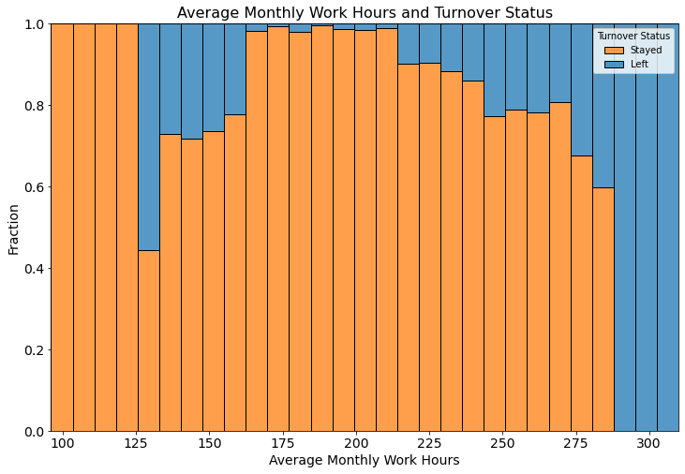
Salifort Motors’ Employee Turnover Project
Building an ML model to predict turnover
There is a high rate of turnover among Salifort Motors employees. As a first step, the leadership team asked the DS team to design a model that predicts whether an employee will leave the company based on their job title, department, number of projects, average monthly hours, and any other relevant data points. A good model will help the company increase retention and job satisfaction for current employees, and save money and time training new employees.
We built and cross-validated two ML models: Extreme Gradient Boosting (XGB) and Random Forest (RF) models. Both models predicted the turnover status fairly well. The best among those was XGB model. It had the following evaluation metric test scores: recall = 0.93%, f1 = 94%, precision = 95%, accuracy = 98%.
Top five predictive features of the employees' turnover are 1) job satisfaction, 2) average monthly work hours, 3) last evaluation scores, 4) number of projects and 5) tenure. The independent variables with the lowest feature importance were salary levels, promotion in the last 5 years and department.
- Those who left the company were most likely to be overworked or underworked, had lower job satisfaction, contributed to more projects, had low salary levels and had slightly higher last evaluation scores.
- Among the departments, Management and RandD had the lowest turnover rates.
- The "optimal" average monthly work hours would be within 168 -210 hours. At this range the turnover rate is minimal.
Recommendations
- Make sure that the employees work 'optimal' hours (168-210 hours per month).
- Keep track of employees who have high evaluation scores but low job satisfaction. Figure out why these employees have low satisfaction levels. Can they be promoted and/or have a raise? Also make sure that these employees have at least medium level of salaries.
- Figure out what factors help the RandD department to have the lowest turnover rates, and see if it is possible to apply these factors to the other departments.
- Take actions to further improve the model: a) Conduct further hyperparameter tuning. b) Add more independent variables (say gender and age) that may increase predictive power of the model.
- Use the model regularly (maybe once or twice a year) to identify the employees who are likely to leave and figure out what can be done to improve their work satisfaction.
- Be aware that the use of the model can lead to an ethical dilemma. By identifying the employees who are likely to leave and taking measures to improve their work satisfaction, the management can reduce turnover. However, if these measures are only directed to those employees, then it may be or may perceived to be unfair toward the rest of the employees.

